Slide 1

Chicago Crime Data Analysis
By
Saptarshi Majumder
22/08/2024

Slide 2
Project analysis slide 2
Project Analysis
Introduction
Insights
AGENDA
Data Model And Cleaning
Dashboards
Crime Rate And Trend Analysis
Conclusion

Slide 3

Chicago Crime Data –
Chicago is a city in the United States of America, located in the state of Illinois.
The data presented is the registered crimes data in the city of Chicago.
This dataset typically includes details about various crimes reported in Chicago, such as types of crimes, locations, dates, and additional attributes.
It also consist of cases those resulted in arrest or not.

Slide 4
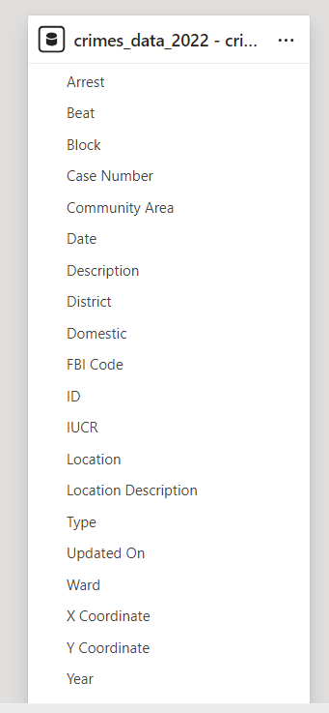
Project analysis slide 4
Data Model And Cleaning
Data Evaluation
Data Evaluation is done based on Crime Rate.
Blank And Full Null Rows Has Been Removed.
Data Cleaning
Based On Crime Rate We Generalized Count Of Domestic And Non-Domestic Cases And Also Region Wise Distribution Of Crime.
Cleaned Data
Descriptive Analysis
Crime Rate
Data Type has been changed to preferred type and columns “null” has been replaced with “Not Available”.
Output From Power Query Editor
Analysis Based On The Overview Of The Data
Data Preparation
This helps us building an understanding on what type of crime is being commited and at which pace.
Types Of Crime

Slide 5
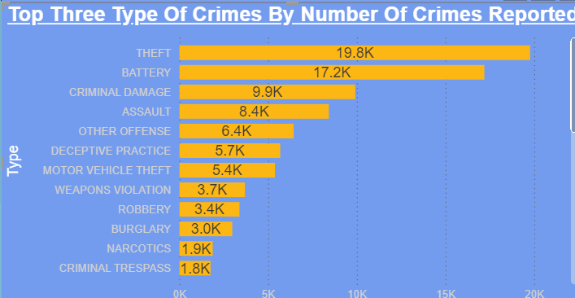
Project analysis slide 5
Crime Type Analysis
The top three crimes in the chart are the top reported crime type.
These top crimes are also considered as the most fatal crimes sometimes.
These charts shows the overall crime type by crime rate in Chicago.

Slide 6
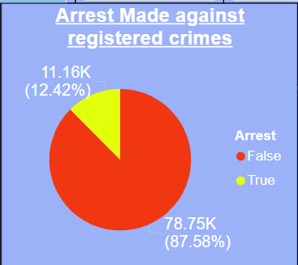
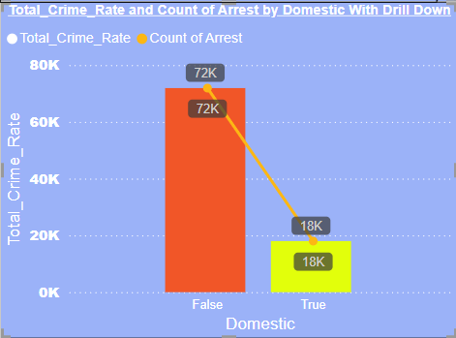
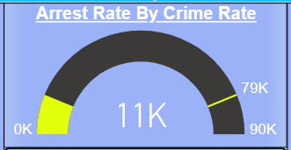
Project analysis slide 5
Crime And Arrest Rate Analysis
Total Arrest Made
Crime Rate
Total Non-Arrested Cases
11,164
89,916
78,752
Total arrest made from all the registered cases in the data.
Total Crime Registered for the year 2022 in the city of Chicago
Total Amount Of Crime Rate which didn’t resulted in an arrest including both domestic and non-domestic.

Slide 7
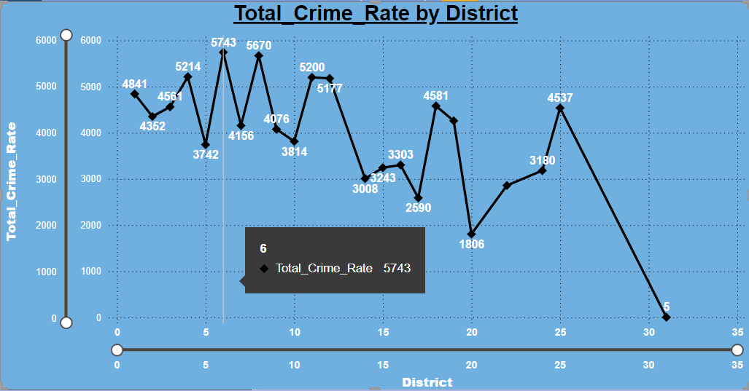
Project analysis slide 5
Crime Rate Analysis
High Crime Rate Districts – Crimes
6 – 5743
8 – 5670
11 – 5200
4 – 5214
Fluctuation Of Crime Rate Can Be Observed According To Different Districts.

Slide 8
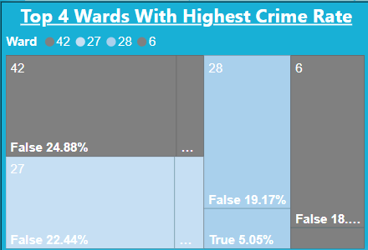
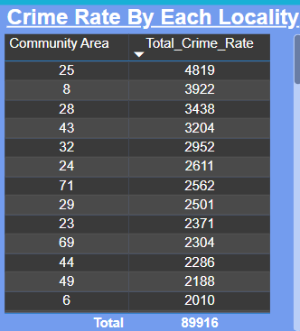
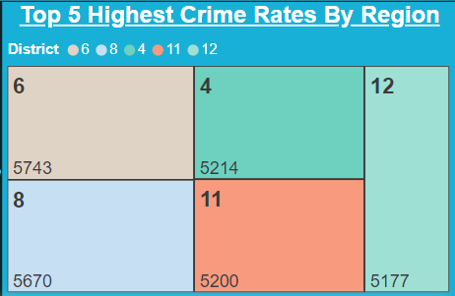
Project analysis slide 6
Location Analysis
These four Wards have the highest crime rate among all the wards.
The localities with the gigh crime rate in descending order are described in these table.
It help us to understand the distribution of reported crimes in these regions.
These chart also helps us to understand the division of arrest made in those top five districts.
The prime focus for improvement should be focused on the high crime rate locality.
These five districts have the highest crime rates among all the districts..

Slide 9
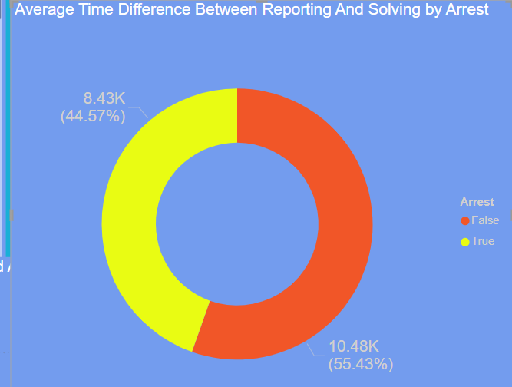
Project analysis slide 11
Report And Solving Time Analysis
The average time for Arrested cases is 14,372.18 Minutes and for unsolved cases i.e. Non- Arrested Cases is 13,065.13 Minutes.
I am considering a case solved if the Arrest has been done.

Slide 10
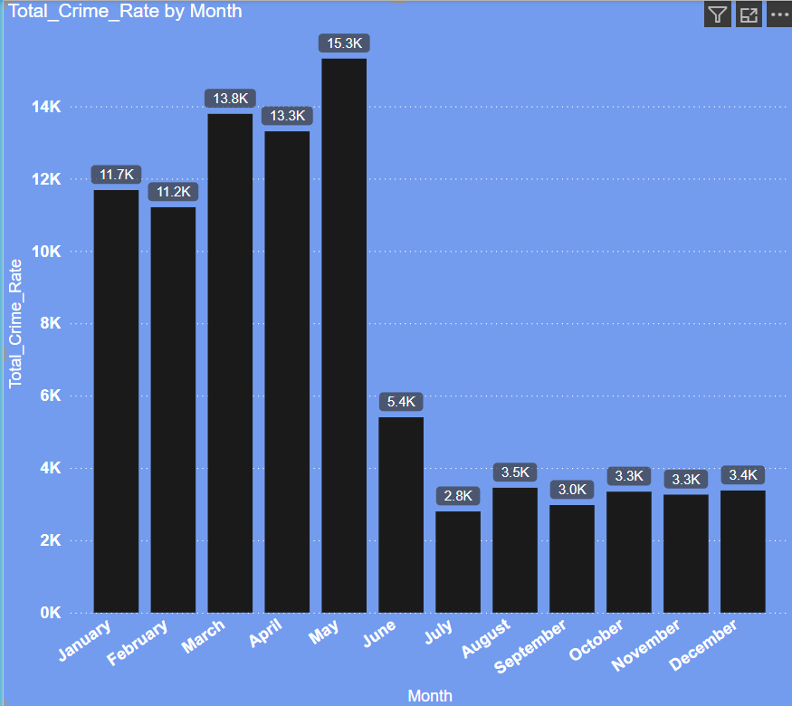
Project analysis slide 10
Crime Month-Wise Trend Analysis
The crime rate of January - May months overall crime rate is the highest compared to June – December months.
The crime rate is the highest in the month of May and crime rate is lowest in the month of July.
A trend of crime rate drop can be noticed from Jan – May and Jun – Dec.

Slide 11
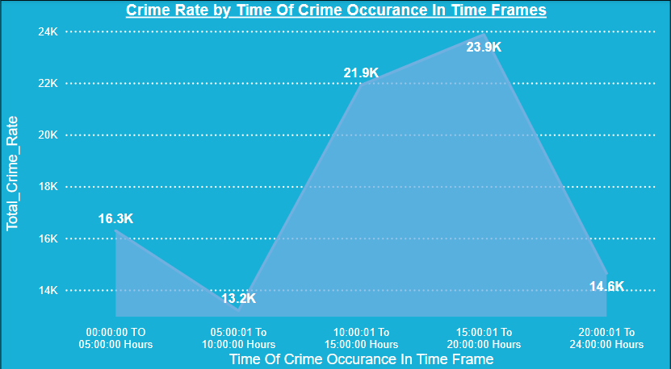
Project analysis slide 10
Crime Time Frame Trend Analysis
A fluctuation of crime rate can be observed based on different time frames.
The crime rate is the highest in the time frame of 15:00:00 – 20:00:00 Hours and crime rate is lowest in the time frame of 05:00:00 – 10:00:00 Hours.
A rise of crime rate can be observed from 10:00:00 Hours to 20:00:00 Hours and decrease can be observed from 20:00:0 Hours.

Slide 12
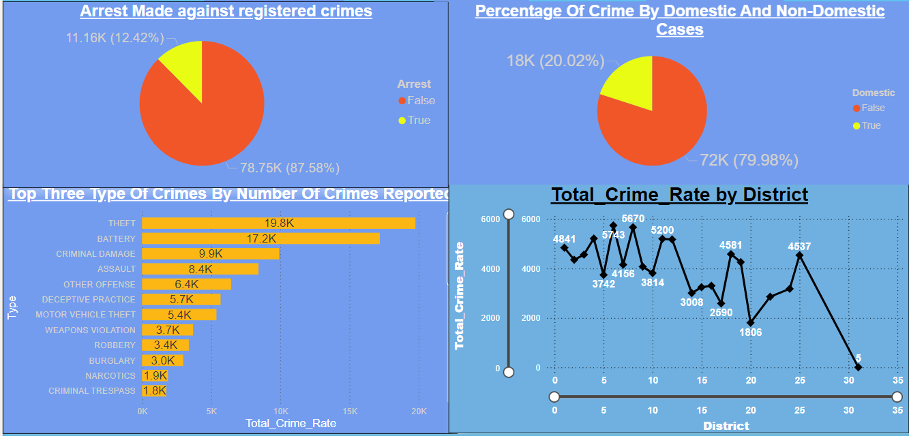
Project analysis slide 10
Crime Reduction Insights
Increase patrol in the specific districts and locality with high crime rate.
Main focus on high crime rate types such as THEFT, BATTERY, CRIMINAL DAMAGE.
We can provide them the option of panic button which can be directly linked with the control room so that nearest patrol can be notified with their location.
Increase the arrest rate up to minimum of 50% according to the crime rate of that specific locality.

Slide 13
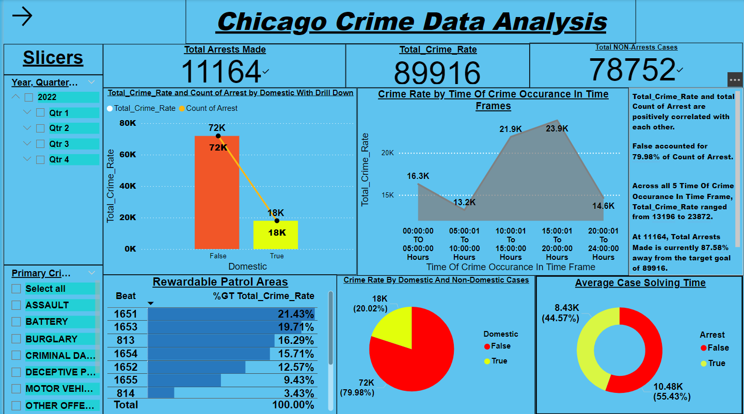
Project analysis slide 10
This tab helps us view the overall crime rate progression in Chicago.
Crime rate by domestic helps us visualize the crimes committed are domestic or not.
With a drill down in that chart we can deep drive into the domestic data to view crime rate by districts.
Main Tab Dashboard

Slide 14
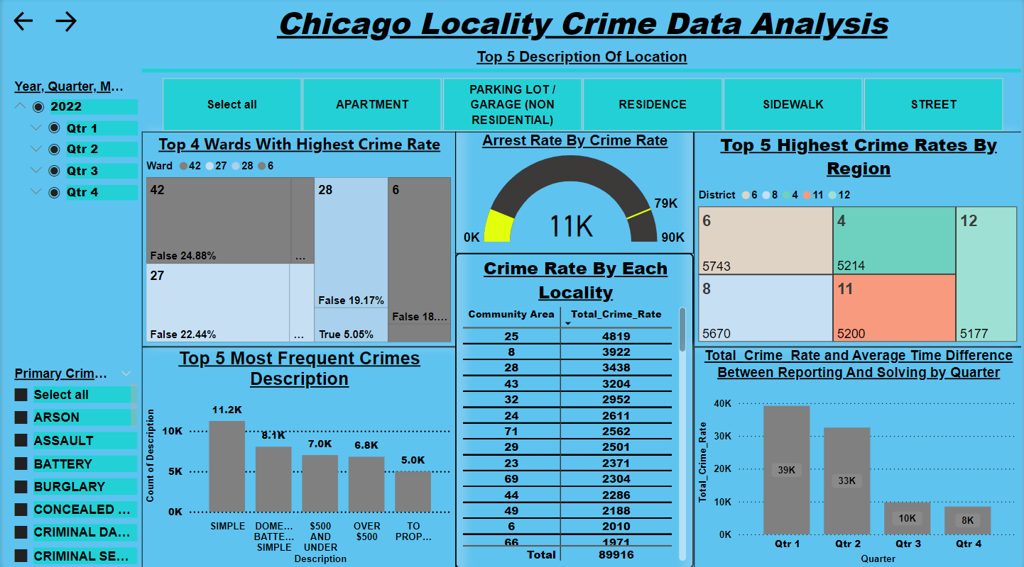
Project analysis slide 10
Locality Tab Dashboard
This tab helps us view the frequency of crime rate occurring in each district, ward or community area.
The charts highlights the Top Wards, Districts and Community Areas in respect of high crime rates.
These gives us a deep dive analysis on the locality of high crime rate.
These regions should be focused for crime rate reduction.
With a drill down in avg time diff and total crime rate chart we can deep drive into the locality data to view time diff of solving based on different districts.

Slide 15
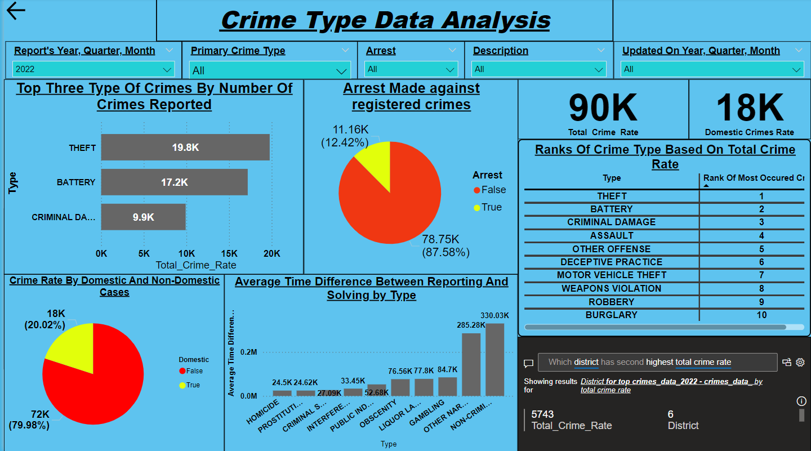
Project analysis slide 10
Crime Type Tab Dashboard
This tab helps us view the frequency of crime type reported
The charts highlights the top crime type based on crime rate along with whether the arrest has been made or not or the case were domestic or not..
The ranks of crime type can be viewed based on crime rate in the table.
And also the average time taken by each type of case to solve.
With a drill down in avg time diff chart we can deep drive into the crime type data to view time diff of solving based on different community.

Slide 16
Project analysis slide 8
Overall Analysis
POSITIVE
NEGATIVE
STRENGTH
WEAKNESS
A decrease in month-wise crime rate can be observed which is the result of special operations being properly implemented.
Domestic cases are quite low compared to Non-Domestic cases.
The top crime type is still the highest even after implementation
The average solving time got increased after the drop of crime rate got increased.
Arrest made cases percentage is quite low compared to Non-Arrested cases.
INTERNAL
OPPORTUNITY
THREAT
Different operations can be done based on the areas where the high crime rate is focused on.
Public awareness and Patrols vigilance can be increased.
A reward system can be implemented for top performing areas for increasing activeness of patrol stations.
The continuous increase of theft, battery and criminal damage can result into fatal causalities.
The rise in crime rate in the secured areas such as airports, etc. can result into damage of the system.
EXTERNAL

Slide 17
Conclusion
-Crime Rate Analysis-
This analysis helped with an overall review of the progression of crime rate across different regions.
This help us decide whether our current operation is being effective or not.
-Crime Type Analysis-
This analysis helped with an overall review of the progression of each crime type across different regions based on crime rate.
This help us decide if the operation is helping us reduce different crime types.

Slide 18

References –
TA Sessions with Ruchita Saha.
TA Sessions with Chandra Prakash Jagrat.
TA Sessions with Prabhat Kumar Mishra.
TA Sessions with Akshat Raj.
Microsoft Power Bi Theme Site Website.

Slide 19
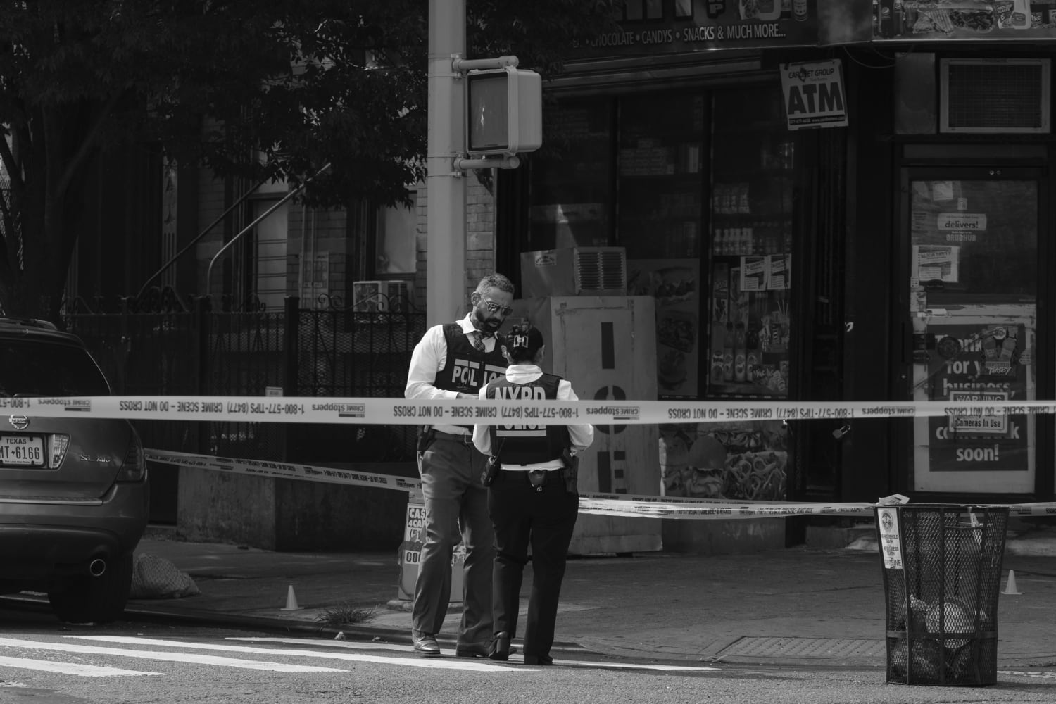
Thank You

